Slide 1
AZURE CLOUD SHELL
Introduction

Slide 2


Hello!
I Am Victor Silva
Twitter: @vmsilvamolina
Blog: https://blog.victorsilva.com.uy

Slide 3

AZURE CLOUD SHELL?

Slide 4
“
Azure Cloud Shell is an interactive, browser-accessible shell for managing Azure resources.
“

Slide 5

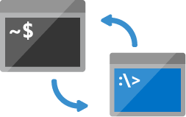

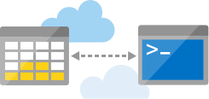
Shell access from virtually anywhere (https://shell.azure.com)
Choose your preferred shell experience (Bash and PowerShell)
Common tools and programming languages included
Persist your files in attached cloud storage

Slide 6
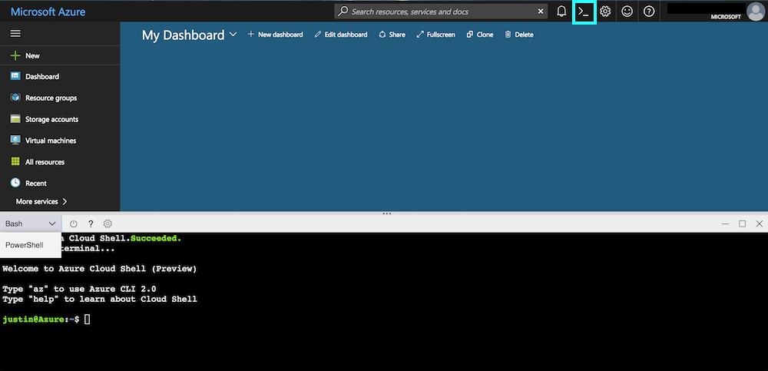

Slide 7
CUSTOMIZE EXPERIENCE
Experience | URL
Most recently used shell | https://shell.azure.com
Bash | https://shell.azure.com/bash
PowerShell | https://shell.azure.com/powershell

Slide 8
PERSIST FILES IN AZURE CLOUD SHELL

Slide 9
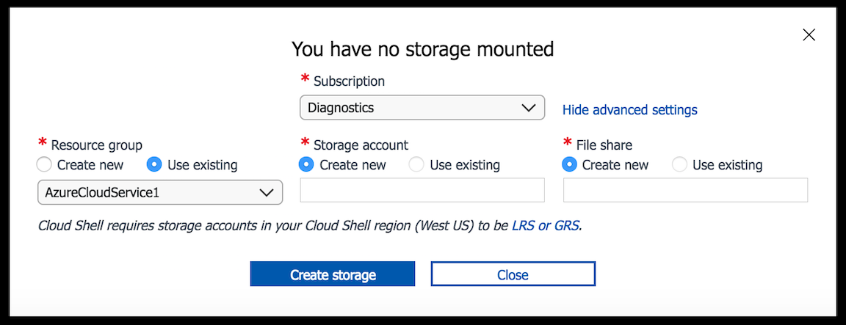

Slide 10
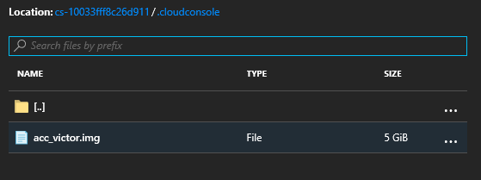

Slide 11
TRANSFER LOCAL FILES TO CLOUD SHELL

Slide 12
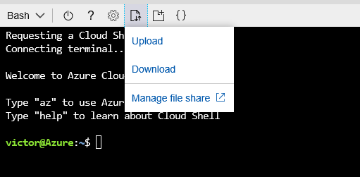
DOWNLOAD/UPLOAD FILES

Slide 13
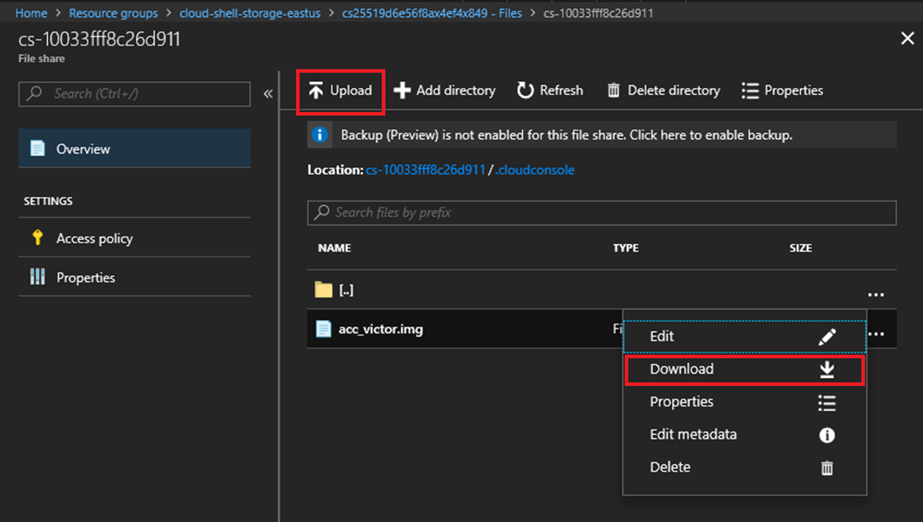
DOWNLOAD/UPLOAD FILES (2)

Slide 14
USING THE AZURE CLOUD SHELL EDITOR

Slide 15
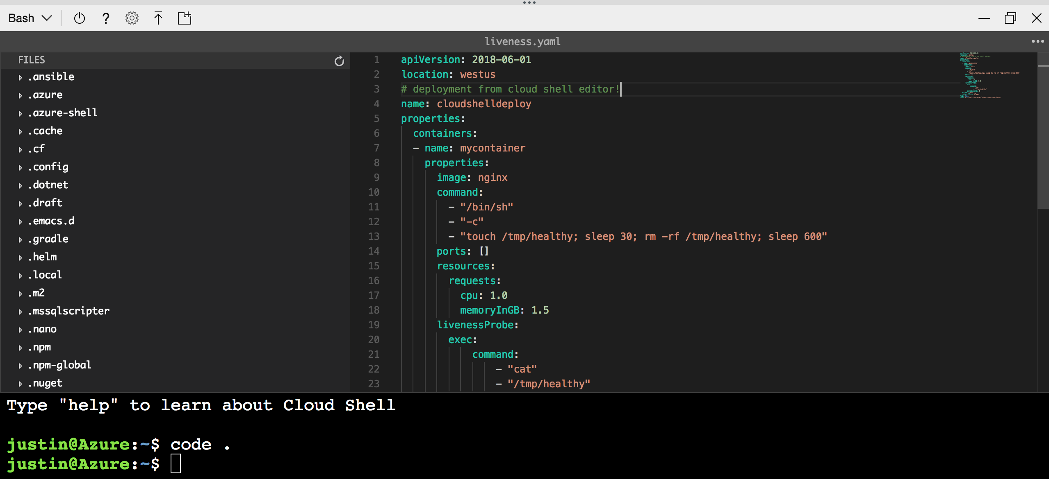
Monaco Editor
code editor that
powers VS Code

Slide 16
TIPS
code abre el editor.
code . abre el editor junto a la carpeta actual.
code <filename> abre el archivo para leer/editar.

Slide 17
AZURE CLI

Slide 18
OVERVIEW
Cross platform CLI for provisioning and managing Azure infrastructure.
Run on macOS, Linux or Windows.
Run on Azure Cloud Shell :)
Create and manage Azure resource from command line.
Write scripts to create and manage Azure resource.

Slide 19
AUTHENTICATION
az login - interactivo
az login –u username –p password - no interactive
az login --service-principal –u http://my-app
–p password –tenant tenant

Slide 20
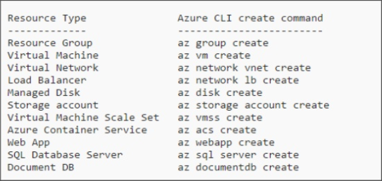
EXAMPLES

Slide 21


DEMO
Generar un playbook
Administrar recursos en Azure
Utilizar Azure Cloud Shell

Slide 22
Thanks!
Any questions?
You can find me at:
@vmsilvamolina / blog.victorsilva.com.uy

